Slide 1
Hashing and Hash tables ADT
CPSC 131 - Data Structure
Shrinivas Patil

Slide 2
Hashing
Process of generating fixed size output from variable size of input
For this mathematical formulas are used
The technique determines the index for storage of item in data structure
Hash tables are used to do hashing

Slide 3
Need of hashing
Internet data packages are of variable size
Difficult to store efficiently
Array simple data structure is also used then why we need hashing
Because of ‘efficiency’ array takes O(1) to store and O(logn) to search. But if you consider large datasets its still lot of time.
So we need data structure that store and search in O(1) time. For that hash tables came in play.
If you use key as index, index will be always an integer. But we have other types of keys as well like string, float etc. What will be the solution.

Slide 4
Solution: Hash Function
Hash function: function that maps an object to an integer in a known range
Receives input key and returns the index of an element in hash tables
The index is known hash index
A Key can be anything string or integer which is fed as input in the hash function the technique that determines an index or location for storage of an item in a data structure.
Example: H(X) = X%10

Slide 5
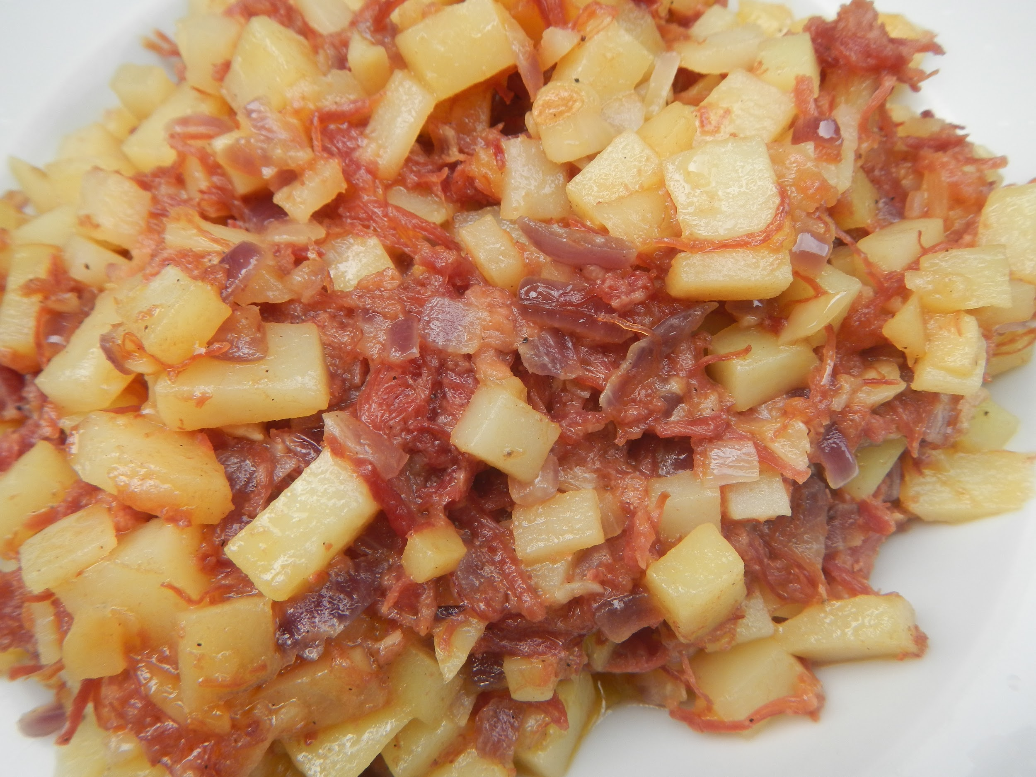
Second Try: Use a Key as an Index
(Better) idea: use hash(key) as a vector index; create vector v where
v[hash(key)] = pointer to pair with that key, or nullptr if key is absent
0
1
(4, “dog”)
Suppose hash(key) = key*4 % 5
2
3
4
(1, “cat”)

Slide 6
Remaining Problems
How to define hash(key)
Collision: when two different keys have the same hash
E.g. what if hash(1) == hash(4) ?
Stay tuned

Slide 7
Dream Hash Function
Ideally, hash(key) has two properties:
Consistent: if x == y, then hash(x) == hash(y)
No collisions: if x != y, then hash(x) != hash(y)
Bad news: property 2 is impossible
0
1
(4, “dog”)
2
3
4
(1, “cat”)

Slide 8
Settle for Improbable Collisions
Universal hash family: a “family” of similar hash functions
Can pick one at random
Collisions are unlikely, but possible
When we create a hash table, we pick a random hash function out of the family
#collisions becomes a random variable
So some hash table operations run in O(1) expected time

Slide 9
Universal Hash Functions
If hash(key) is chosen randomly from a universal hash family, then
Consistent: if x == y, then hash(x) == hash(y)
Rare collisions: if x != y, then Pr[hash(x) == hash(y)] ≤ 1/m

Slide 10
Two-Step Hash Functions
Recall: key type K could be just about anything
In practice, hash(key) is a two-step process hash(key): return h(code(key))
unsigned code(K key): map key type K (e.g. int, string, etc.) to an unsigned integer
size_t h(unsigned c): map code (unsigned integer) to an array index in [0, m-1]
Modularity: the universal hash family h(c) is independent of key type K

Slide 11
Types of hash Functions
Division method
Mid square method
Folding method
Multiplication method
Division Method: Easy and simple method, divides key k with M size of hash table and use remainder of it.
h(K) = k mod M
k = 12345
M = 95
h(12345) = 12345 mod 95
= 90
Cons: Poor performance consecutive keys map to consecutive hash indices.

Slide 12
Types of hash functions
Mid-square method: good method, two step hashing.
Square the key k i.e. k*k
Take middle r digits from square of key r can vary from 0 to 2^r -1.
h(K) = h(k x k)
k = 60 k x k = 60 x 60 = 3600 h(60) = 60
The hash value obtained is 60
Cons: Size of hash value can be concern

Slide 13
Types of hash functions
Folding Method: Two step method.
Divide key in segments where each part has equal digits except last segment can have lesser.
Add this segments. The hash value is obtained by taking modulus with size of table.
k = k1, k2, k3, k4, ….., kn
s = k1+ k2 + k3 + k4 +….+ kn
h(K)= s
k = 12345
k1 = 12, k2 = 34, k3 = 5
s = k1 + k2 + k3
= 12 + 34 + 5
= 51
h(K) = 51
The number of digits in each part depends on the size of hash table

Slide 14
Types of hash function
Multiplication Method:
Perform following steps:
Choose a value A from 0<A<1
Multiply key value with A
Extract fractional part
Multiply it with size of hash table and take floor value of it.
h(K) = floor (M (kA mod 1)
k = 12345 A = 0.357840 M = 100
h(12345) = floor[ 100 (12345*0.357840 mod 1)] = floor[ 100 (4417.5348 mod 1) ] = floor[ 100 (0.5348) ] = floor[ 53.48 ] = 53

Slide 15
Properties of hash function
Efficient
Uniformly distribute the keys
Minimize the collisions
Should have Low load factor
Load factor: number of items in the hash table divided by size of the table
LF = (number of items in hash table) / (size of table)
Load factor decides when the capacity of hashtable should be increased.

Slide 16
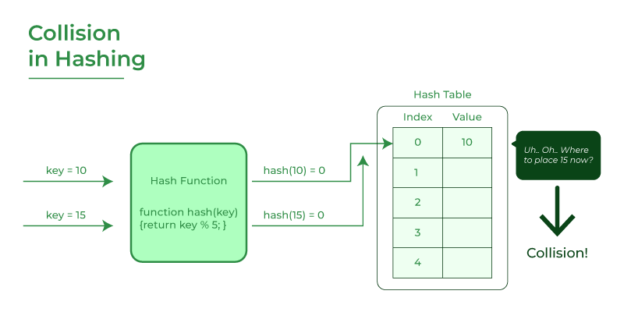
Collision
The hashing process generates a small number for a big key,
so there is a possibility that two keys could produce the same value.
The situation where the newly inserted key maps to an already occupied is known as collison

Slide 17
Collision resolution Techniques
There are two ways to resolve collision
Separate Chaining (open hashing)
Open Addressing (closed hashing)
Linear Probing
Quadratic probing
Double hashing

Slide 18
Separate Chaining
The idea is to make each cell in a hash table linked to a linked list
Linked list contains the elements have same hash value
It is simple
Requires additional memory outside the hash tables
Example: We have given a hash function and we have to insert some elements in the hash table using a separate chaining method for collision resolution technique.
Hash function = key % 5,
Elements = 12, 15, 22, 25 and 37.

Slide 19
Chained Hash Table
0
66
Hash table has:
Table: vector of m singly-linked lists of pairs
Vector<SinglyLinkedList<pair<K, V>> v:
m: length of this vector; maintain n ≤ m
Random universal hash function
(i.e. multiplicative hash function)
Each table element is a bucket,
v[hash(key)] = SLL of pairs where each pair.first == key
A bucket may be empty
94
87
32
24
77
23
5
m-1

Slide 20
Constructor and Size
0
66
template<K, V> class ChainedHash { private: Vector<SLList<pair<K, V>>> v_; MultiplicativeHash hash_; int n_; public: ChainedHash() : v_(4), hash_(4), n_(0) { } int Size() { return n_; }
94
87
32
24
77
23
5
m-1
Each is O(1) worst-case time

Slide 21
Search(key)
0
66
bool Search(K key) { int i = hash_.h(key) for ( pair<K, V> p : v_[i] ) { if (p.first == key) { return true; } } return false; }
94
87
32
24
77
23
5
m-1
Let L = expected length of a bucket
O(L) time

Slide 22
Insert(pair)
0
66
bool Insert(pair<K, V> q) { if (Contains(q.first)) { return false; } if (n_ == v_.size()) { Resize(); } int i = hash_.h(q.first) v_[i].AddFront(q) n_++ return true; }
94
87
32
24
77
23
5
m-1
Let L = expected length of a bucket
O(L) amortized time
“amortized” due to occasional resizing, like vector

Slide 23
Erase(key)
0
66
94
87
bool Erase(K key) { if (!Contains(q)) { return false; } int i = hash_.h(key) for ( pair<K, V> p : v_[i] ) { if (p.first == key) { v_[i].erase(p) } } n_-- return true; }
32
24
77
23
5
m-1
Let L = expected length of a bucket
O(L) time

Slide 24
Asymptotic Efficiency
Operation | Chained Hash Table
Constructor (create empty) | O(1)
Contains(key) | O(L)
Find(key) | O(L)
Insert(pair) | O(L) amortized
Erase(key) | O(L)
L = expected length of a bucket

Slide 25
Open Addressing
In open addressing, all the elements are stored in hash tables itself
Table contains either an element or NIL
In searching, we examine the table until that element is not found or we confirm that element is not present in the table.
There are 3 types
Linear Probing
Quadratic Probing
Double hashing

Slide 26
Linear Probing
Hash table is searched sequentially starts from original position
If the hash index is already occupied then go for next empty position
If collision occurs then perform rehashing is done until empty location is not found
rehash(key) = (hash(x)+1)%table_size.
Let hash(x) be the slot index computed using a hash function and S be the table size
If slot hash(x) % S is full, then we try (hash(x) + 1) % S If (hash(x) + 1) % S is also full, then we try (hash(x) + 2) % S If (hash(x) + 2) % S is also full, then we try (hash(x) + 3) % S

Slide 27
Linear Probing
Example : Consider the H(x) = x%7 and keys are 50, 700, 76, 85, 92, 73, 101
Challenges:
Primary clustering: Many consecutive elements forms group and its start taking more time to find free slot.
Secondary clustering is less severe. Only two elements have same collision chain if their initial position is same

Slide 28
Quadratic Probing
Solves primary clustering problem
In this method, we look for i^2 th position in i th iteration.
If only hash index is occupied then we check for other slots.
reshape(x) = (hash(x)+i*i) % size
let hash(x) be the slot index computed using hash function.
If slot hash(x) % S is full, then we try (hash(x) + 1*1) % S If (hash(x) + 1*1) % S is also full, then we try (hash(x) + 2*2) % S If (hash(x) + 2*2) % S is also full, then we try (hash(x) + 3*3) % S

Slide 29
Quadratic Probing
Example : consider table size=10 and hash function H(x) = x%7 and keys are

Slide 30
Double Hashing
Reduced clustering in optimized way
Increments are calculated by another hash function
Generally hash2(x) is used to find slot using i*hash2(x) in i th iteration.
rehash(x) = (hash(x) + i*hash2(x))%size
let hash(x) be the slot index computed using hash function.
If slot hash(x) % S is full, then we try (hash(x) + 1*hash2(x)) % S If (hash(x) + 1*hash2(x)) % S is also full, then we try (hash(x) + 2*hash2(x)) % S If (hash(x) + 2*hash2(x)) % S is also full, then we try (hash(x) + 3*hash2(x)) % S

Slide 31
Double hashing
Example : Insert the keys 27, 43, 692, 72 into the Hash Table of size 7. where first hash-function is h1​(k) = k mod 7 and second hash-function is h2(k) = 1 + (k mod 5)

Slide 32
Performance of open addressing
Performance is measured same as chaining
Load factor is used to calculate performance
m = size of hash table
n = Number of keys inserted in the hash table
Load factor α = n/m ( < 1 )

